Slide 1

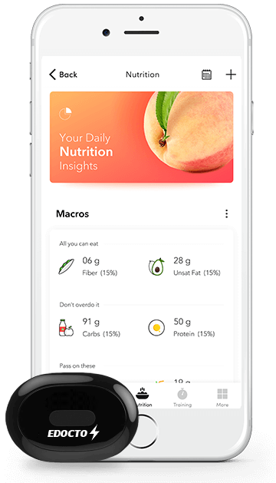

A Complete Fitness APP

Slide 2
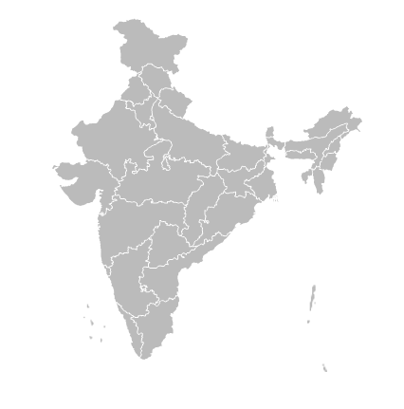
PROBLEM
250M+
150M+
50M+
Hypertensive Indians
Obese Indians
Diabetic Indians
70%
of metropolitan population
Out of 450M urban population of India.

Slide 3




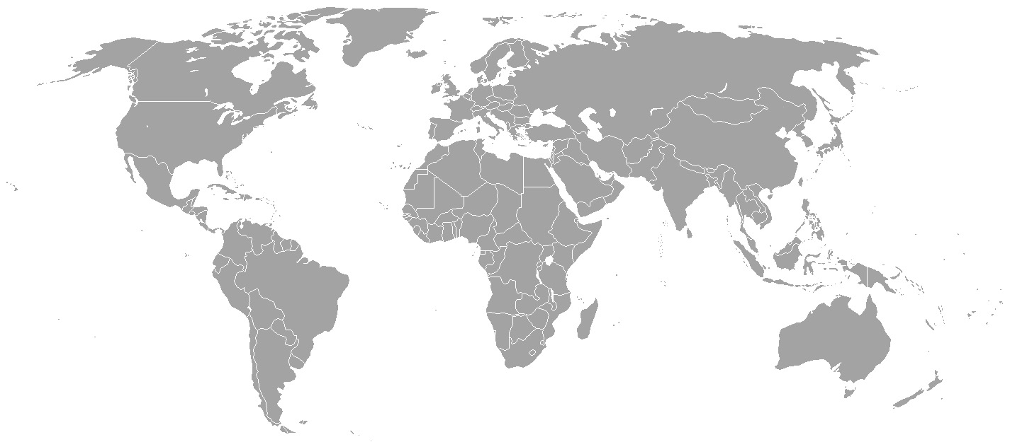
PROBLEM
PROBLEM
Tracking
How do we track the nutrition ?
Tedious Tracking Process
Unorganized & Insufficient Food Database
Less trained nutritionist

Slide 4
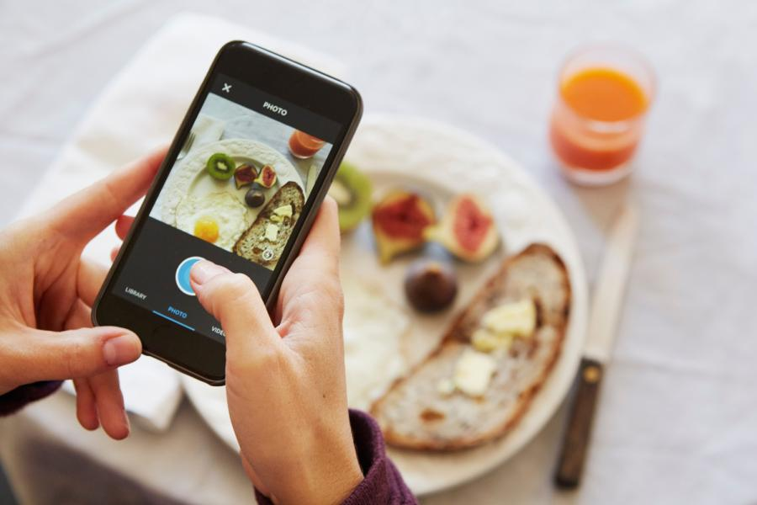
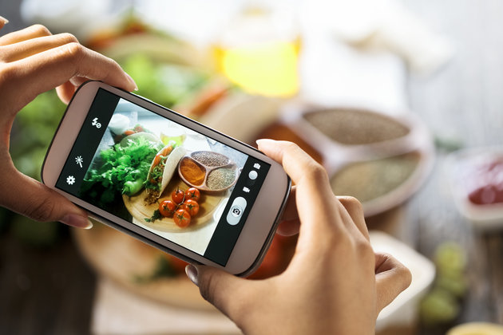

OUR PRODUCT
#1. Nutrition Tracker
OPEN CAMERA
TAKE PICTURE
EASY TRACKING

Slide 5




OUR PRODUCT
#2. AI Assistant
Fitness Assistant
AI based food suggestions.
Activity Tracking
Disease specific plans

Slide 6
KEY FEATURES
Nutrition Tracking
Sync With Any Tracker
Image processing based
Connection with most of the devices.
Activity Tracking
Analytics
Calories burn, steps count, pulse rates, sleep tracking.
Customized analytics
Personalized Suggestions
Leaderboards
Food suggestion based on your health status.
Family, friends sharing with leader board.

Slide 7
PROS & CONS
PROS
CONS
Why we are different.
We are looking to improve this.
IMPROVEMENTS
OBSTACLES
IMAGE PROCESSING
REGIONAL FOOD VARIETY
FREE OF COST
LARGE DATASET
ACCESSIBILITY
ASSISTANT
SYNC WITH ANY TRACKER
SPEED

Slide 8
MARKET SIZE
450M+
350M+
250M+
Urban Population
Smartphone Users
Lifestyle disease
INDIAN MARKET

Slide 9


COMPETITON
Vs
(1M downloads )
Paid
Free of cost.
Manual logging
Easy food tracking.
Multi-Domain
Specific Domain Focusing App.
20,000 food database.
Large & regional database.
No assistant
AI assistant.

Slide 10
ACHIEVEMENTS
Prizes
Top10 Finalist
Vincenza, MDI, Gurgaon
Gandhi Fellowship Award
Organized by TPO, AMU
Management Faculty, AMU
E-Summit’17 IIT Kanpur
E-Summit’17 IIT Madras
TechFest’17 IIT Kanpur

Slide 11


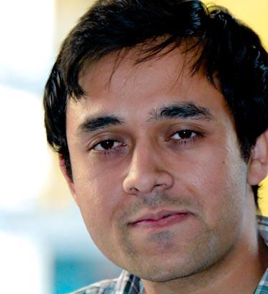
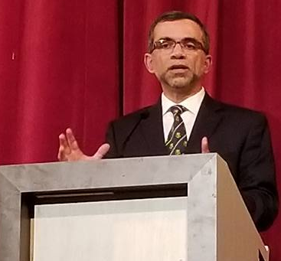

MENTORS
Ale Imran Sir Coordinator E-Cell, AMU
Sayad Naved
Investor, North America
Mayank Agarwal
Harvard University Alumni

Slide 12
REVENUE MODEL
(Expecting 10M App downloads in 3 years)
10,000
Subscriptions
Subscription Model
120 Lacks
Expecting 10,000 Subscriptions with the cost of ₹100 per month
30,000
Per Year
Affiliate Products Selling
30 Lacks
Selling third party products by taking average ₹100.
3M Clicks Per Month
Content Monetization & Others
100 Lacks
At the standard rate of $4 per 1000 clicks
3 Crores
* Earning for 1st year only

Slide 13
FUNDING UTILIZATION
Cloud Management
Marketing
APP
Cloud Management
Product Promotion
App Development
To maintain the images database for image recognition
To get the initial traction of the product.
Developers to accelerate the app development.
50%
30%
20%
Seed Fund Required :10Lacks.

Slide 14

THANK YOU!
QUESTIONS?
proper nutrition is the new fitness solution.

